Slide 1








QuickBite Express
Crisis Recovery Strategy
Strategic Data-Driven Approach to Restore Growth
Pre - Crisis
Crisis
Presented by:
Sonali Patil
Data Analyst
November 1, 2025

Slide 2










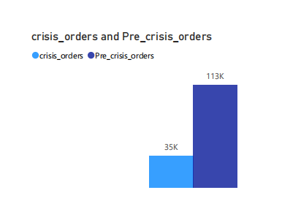


Executive Summary: Crisis Impact & Recovery Goals
QuickBite Express | November 1, 2025
The Crisis at a Glance
Our Path to Recovery
In June 2025, QuickBite Express faced a significant crisis stemming from widespread food safety violations and a severe delivery outage during the monsoon season, eroding customer trust and operational stability.
This recovery strategy aims to systematically address the crisis's aftermath by:
Rebuilding customer and partner trust through transparent communication
Quantifying the Impact
Reactivating lost users with targeted incentives and re-engagement campaigns
Order Volume Drop
Implementing a more resilient operational framework to prevent future disruptions
28% decrease in total orders during June 2025 - September 2025
Ensuring sustainable growth through improved quality control and delivery reliability
- 2.3x increase in cancellation
Cancellation rate is increased 2.3 times as compared to before June 2025
Customer Satisfaction Score Decline
SLA compliance fell by 15%
Decline from 4.2 to 2.8 (out of 5) in average customer satisfaction
Pre-Crisis (May 2025)
Crisis Period (June 2025)
Page 2/10

Slide 3


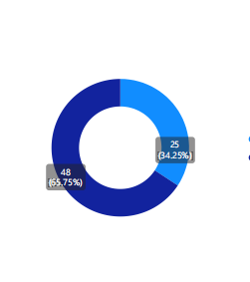


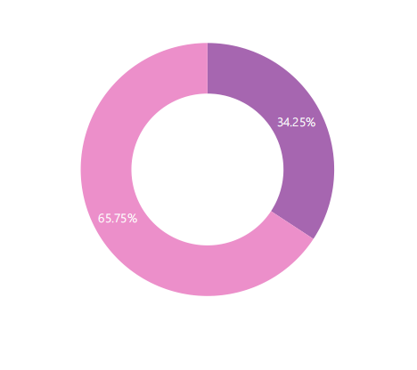
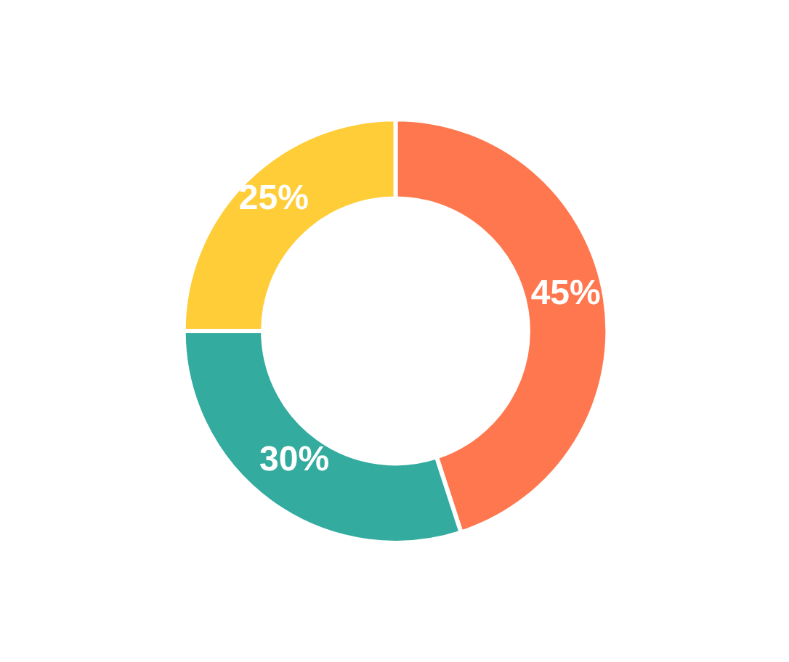






Customer Segmentation: Targeting Recovery Efforts
QuickBite Express | November 1, 2025
Pre-Crisis Revenue Share
Loyalists at Risk
High Priority
High-value customers with decreased activity during crisis
Frequent users before crisis, showing reduced engagement. Risk of future attrition if not addressed proactively.
Churned High-Value Users
High Priority
Previously frequent high-spending customers who became inactive
Complete cessation of orders, representing substantial revenue loss. Critical for significant revenue recovery.
New & Occasional Users
Medium Priority
New users post-crisis and existing infrequent customers
Loyalists at Risk (45%)
Churned High-Value (30%)
New & Occasional (25%)
Lower immediate recovery value but offer long-term growth potential. Require different incentives to increase frequency.
Strategic Recommendation
Focus recovery efforts on Loyalists at Risk and Churned High-Value Users first, as they represent the majority of pre-crisis revenue. Implement targeted re-engagement campaigns with personalized offers to maximize impact.

Slide 4




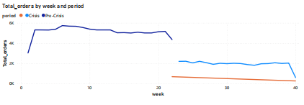













Order Pattern Analysis: Pre-Crisis to Recovery
QuickBite Express | November 1, 2025
Weekly Order Volume Trend (May-July 2025)
Average Order Value (AOV)
Cuisine Preference Shift
Pre-Crisis
Crisis (June)
Comfort Food: +15%
Healthy Options: -10%
₹450
₹320
International: -10%
Local Delicacies: +5%
-28.9%
Key Insights
Sharp 70% decline in weekly orders during crisis period
Customers prioritized perceived safety and value during crisis

Slide 5




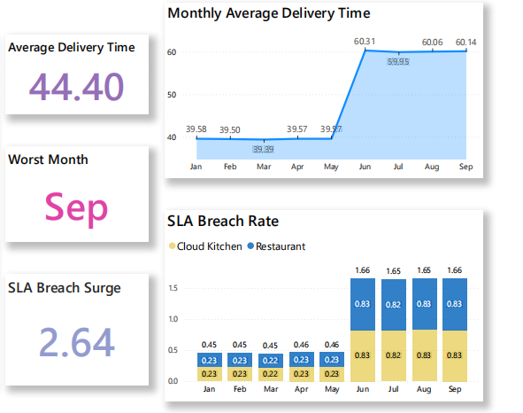





Delivery Performance: SLA Compliance & Cancellations
QuickBite Express | November 1, 2025
SLA Compliance Crisis
The crisis significantly eroded our ability to meet Service Level Agreements (SLAs), leading to widespread customer dissatisfaction.
Delivery SLA Compliance
45%
June 2025 Performance
Target: 90%
Variance: -45%
Key Findings
Significant delays exacerbated by monsoon season
Delivery partners faced operational bottlenecks
System-initiated cancellations increased by 150% during heavy rainfall
Customer trust eroded due to unreliable service

Slide 6

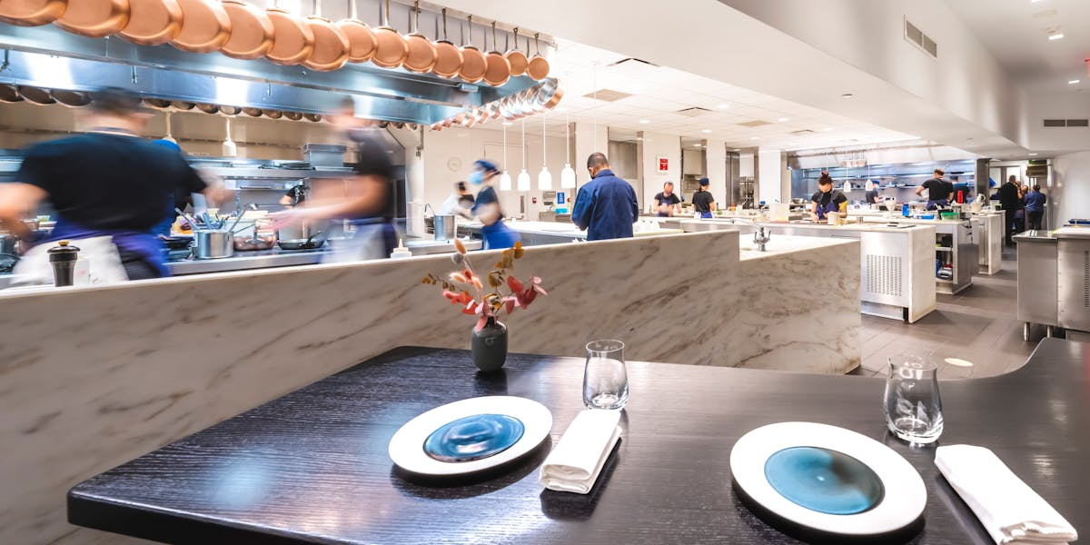



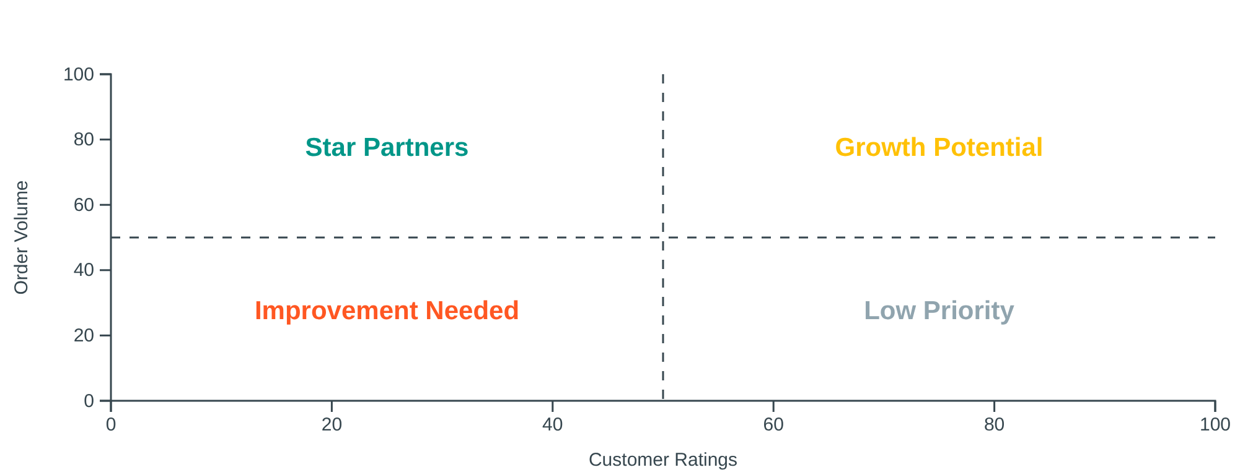












Restaurant Partnership Evaluation
QuickBite Express | November 1, 2025
Partner Attrition Analysis
Remaining Partners Segmentation
The crisis in June 2025 led to significant partner attrition, particularly in areas heavily impacted by delivery failures.
Partner Attrition Rate
20%
Significant loss of restaurant partners, impacting service coverage and variety.
Geographic Impact
Star Partners
Growth Potential
High order volume, high customer ratings. Critical for immediate recovery.
Low order volume, high customer ratings. Need support to increase visibility.
Areas with dense restaurant presence showed higher attrition
Improvement Needed
Low Priority
High order volume, low customer ratings. Require intervention to improve quality.
Low order volume, low customer ratings. Reassessment recommended.

Slide 7




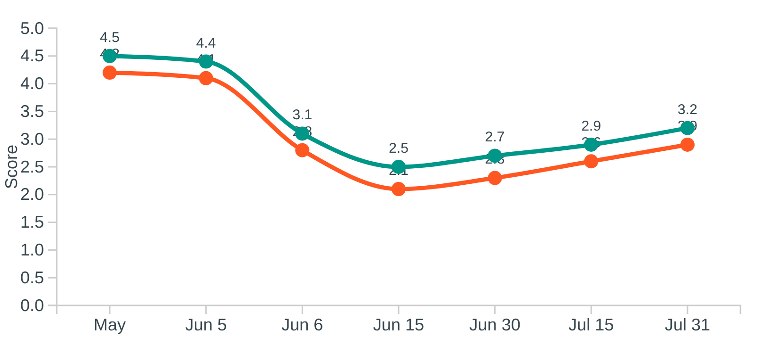



















Sentiment & Feedback Analysis
QuickBite Express | November 1, 2025
Rating & Satisfaction Scores
Review Keyword Analysis
The crisis significantly eroded customer trust, as evidenced by the sharp decline in CSAT scores and app store ratings.
A word cloud generated from customer reviews in June vividly illustrates the immediate and overwhelming negative sentiment.
LATE
CANCELLED
COLD FOOD
UNSAFE
NO SUPPORT
HYGIENE
DELAYED
REFUND
POOR QUALITY
Primary Issues Identified
CSAT Score
App Store Rating
Food Safety Concerns
Delivery Failures
Terms like "unsafe," "hygiene", and "quality" indicate customer concerns about food safety.
Terms like "late," "delayed," and "cancelled" highlight delivery issues during the monsoon season.
Critical Inflection Point
Food safety violation report in early June acted as a critical inflection point, leading to an immediate and sustained drop in metrics.

Slide 8
Competitor Benchmarking
QuickBite Express | November 1, 2025
Recent performance data for Zomato and Swiggy from publicly available financial and business news reports covering the period June–September 2025.
Zomato
- Revenue surged 183% YoY to ₹13,590 crore in Q2 FY26 (Jul–Sep 2025).
- Achieved ₹65 crore net profit, signaling strong operational recovery.
- Benefited from quick commerce expansion and improved margins.
Swiggy
- Reported a net loss of ₹1,092 crore, up from ₹626 crore last year.
- Revenue grew 54% YoY to ₹5,561 crore, but expenses rose 56%, driven by marketing and delivery costs.
- Struggled to contain losses despite growth, indicating operational inefficiencies.
QuickBite Crisis Impact
Customer ratings dropped from 4.49 to 2.58 in June.
- Order volume declined ~40% from pre-crisis to crisis period.
- Cancellation rates doubled, and SLA compliance fell below 75%.
QuickBite’s crisis impact was more severe than Zomato’s and more operationally strained than Swiggy’s.
Zomato capitalized on quick commerce and margin control, while QuickBite faced customer dissatisfaction and loyalty erosion.
Metric | QuickBite | Zomato | Swiggy
Customer Ratings | ↓ 4.49 → 2.58 | Not disclosed | Not disclosed
Order Volume | ↓ ~40% | ↑ 183% revenue | ↑ 54% revenue
Profitability | Declined | ₹65 crore profit | ₹1,092 crore loss
Operational Efficiency | ↓ SLA, ↑ cancels | Improved margins | Rising costs

Slide 9



























Strategic Recommendations
QuickBite Express | November 1, 2025
Based on data analysis, we recommend these actions to drive recovery, rebuild trust, and foster growth:
Customer-Centric Actions
Food Safety & Quality
Delivery Infrastructure
"We're Sorry" Campaign for Loyalists at Risk with personalized credits
"SafeBite Certification" program for restaurant partners
Enhanced Partner Support with weather-proof gear
Aggressive Win-Back for Churned High-Value Users
Rigorous food safety audits and public certification
Dynamic surge pricing during adverse weather
Reduces cancellations and delays
High impact on customer retention
Critical for rebuilding trust
Key Success Factors
Phased Implementation
Platform Improvements
Communication Strategy
Prioritize by impact and feasibility
Continuous Monitoring
In-App Hygiene Rating filter for customer choice
Transparent PR Campaign on recovery steps
Track KPIs with Power BI dashboard
Clear messaging on food safety and delivery
Transparency on safety standards
Rebuilds customer confidence
Empowers informed customer decisions

Slide 10

















Implementation & Monitoring Framework
QuickBite Express | November 1, 2025
Implementation Roadmap
KPI Monitoring Dashboard
Dedicated Power BI dashboard established to track strategic interventions effectiveness
Phase 1: Immediate Response
Key Performance Indicator Target Monitoring Churned Customer Reactivation Rate 25% increase by Q4 2025 Weekly CSAT Score Trend >4.0 average by Q4 2025 Daily Partner Re-onboarding Rate 15% increase by Q4 2025 Weekly Delivery SLA Compliance >95% on-time delivery Daily Food Safety Audit Pass Rate 100% for certified partners Monthly Average Order Value (AOV) Pre-crisis levels + 5% by Q1 2026 Weekly Customer Retention Rate 5% increase month-over-month Monthly Negative Review Sentiment <10% of total reviews Daily
June - July 2025
Launch "We're Sorry" campaign for Loyalists at Risk
Introduce "SafeBite Certification" program
Phase 2: Recovery Building
November 2025 - January 2026
Dashboard Key Features
Implement win-back campaigns for Churned High-Value Users
Enhance delivery partner support infrastructure
Real-time insights
Automated alerts
Exportable reports
Predictive analytics
Phase 3: Growth & Evaluation
February - June 2026
Full-scale launch of In-App Hygiene Rating Filter
Transparent PR & Communication Campaign

Slide 11



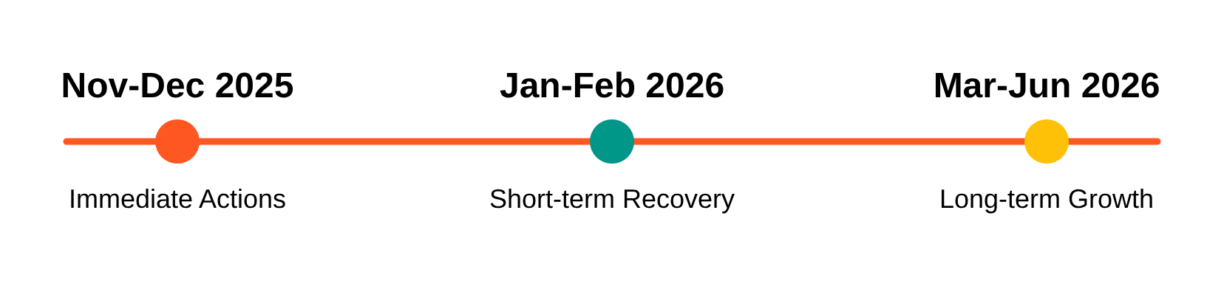















Next Steps & Stakeholder Alignment
QuickBite Express | November 1, 2025
Implementation Roadmap
Resource Requirements & Alignment
Budget Allocation
Personnel
Marketing credits for customer re-engagement
Dedicated recovery team for 6 months
Technology
Partners
Power BI dashboard development
Restaurant partner collaboration
1
Immediate Actions (Nov-Dec 2025)
Launch "We're Sorry" campaign for Loyalists at Risk and initiate "SafeBite Certification" program
Stakeholder Alignment
2
Short-term Recovery (Jan-Feb 2026)
Securing executive buy-in for the proposed strategy and necessary budget allocation is crucial for successful implementation.
Implement in-app Hygiene Rating filter and enhance delivery partner support infrastructure
3
Long-term Growth (Mar-Jun 2026)
Follow-up meeting requested
Schedule Meeting
Complete partner re-onboarding and achieve 25% increase in Churned Customer Reactivation Rate
Recovery Strategy Presentation
Page 10 of 10

Slide 12
THANK YOU
Text

